Slide 1
Retirement Planning Strategies for Educators

Slide 2
Today's Topics
TRS Pension Basics
Understanding the Retirement Income Gap Retirement
Savings Plans Available to You Investment Basics
Social Security Provisions How to get started

Slide 3
RAMS: A National Cooperative
The Retirement Asset Management Services (RAMS) program is a national cooperative established in 2001 by Education Service Center Region 10 in Dallas, TX
RAMS Services
457(b) Retirement Plan
403(b) Administration
401(a) TERRP (Teacher Employee Recruitment & Retention Plan)
FICA Alternative Plan Administration
FinPath Financial Wellness
TCG, a HUB International Company, was selected to manage the RAMS program
Plan Investments are overseen by an investment advisory committee made up for Executive Directors, Superintendents and Chief Financial Officers—ensuring the interests of government employees remain top priority
www.tcgservices.com

Slide 4
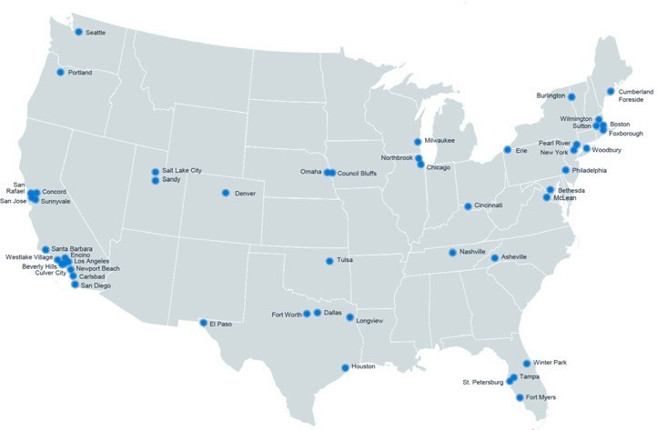
Retirement & Private Wealth Services
We help you get ready for tomorrow
When you work with us, you’re at the center of a vast network of retirement, wealth management, and financial wellness specialists ready to bring clarity to a changing world with tailored solutions and unrelenting advocacy.
Who We Serve
HUB International
By the
Numbers
Organizations
For-Profit companies, Not-for- profit organizations and governmental entities
National Reach | Local Leadership
530+
Locations in North America
Individuals and Families
Mass affluent and high net worth individuals and families
Employees
Workforce and executives
Top 5*
Global Insurance Broker
Advisory
$172B+
Retirement plan assets under advisement
Retirement Plans
10,000
Retirement plans under advisement
17,000+
Employees
*Source: https://bit.ly/21K26Zs
Insurance services are offered through HUB International, an affiliate.
*HUB International Limited (“HUB”) owned RIAs provide investment advisory and management services to its respective clients, under the general trade name of HUB Retirement and Private Wealth. All current HUB RIAs maintain a combined total of $172,292,249,664 in aggregated regulatory assets under management (“Aggregated AUM”), based on the reported AUM for each respective individual HUB RIA effective as of December 31, 2023. The AUM for each individual HUB RIA may be found in the respective Form ADV for each respective HUB RIA. This Aggregated AUM for all HUB RIAs are broken out as follows: $109,326,671,524 in nondiscretionary institutional AUM; which AUM primarily represents qualified retirement plan assets (both ERISA and non-ERISA plans), non-qualified plan assets, and other types of institutional assets. $33,455,679,298 in discretionary institutional AUM; which AUM primarily represents qualified retirement plan assets (both ERISA and non-ERISA plans), non-qualified plan assets, and other types of institutional assets. $29,509,868,842 in Private Wealth Client AUM; which is a combination of both discretionary and non-discretionary AUM.

Slide 5
HUB Investment Partners
Advisory Services
Plan Education Fiduciary oversight
Investment plan design
Investment committee formation and support
Wealth Management & Family Office Services
Full-service investment advisory firm
Provides fiduciary protection over plan investments
Fee-only provider
Acts as the Investment Advisor for the ESC Region 10 Cooperative to support the Investment Advisory Committee (composed of Superintendents & Chief Financial Officers)
Registered with the Securities and
Exchange Commission (SEC)
www.tcgservices.com

Slide 6
TCG Administrators
a HUB International Company
Administration Services
Handles sending salary deferrals to vendor of choice
Handles salary elections and contributions
Responsible for processing loans and distributions daily
Handles all paperwork and compliance for plans
Third-Party Administration Services for the Region 10 RAMS program
One of the nation's largest retirement plan administrators
Focused on K12/Public Service Employees
Nationwide presence
www.tcgservices.com

Slide 7
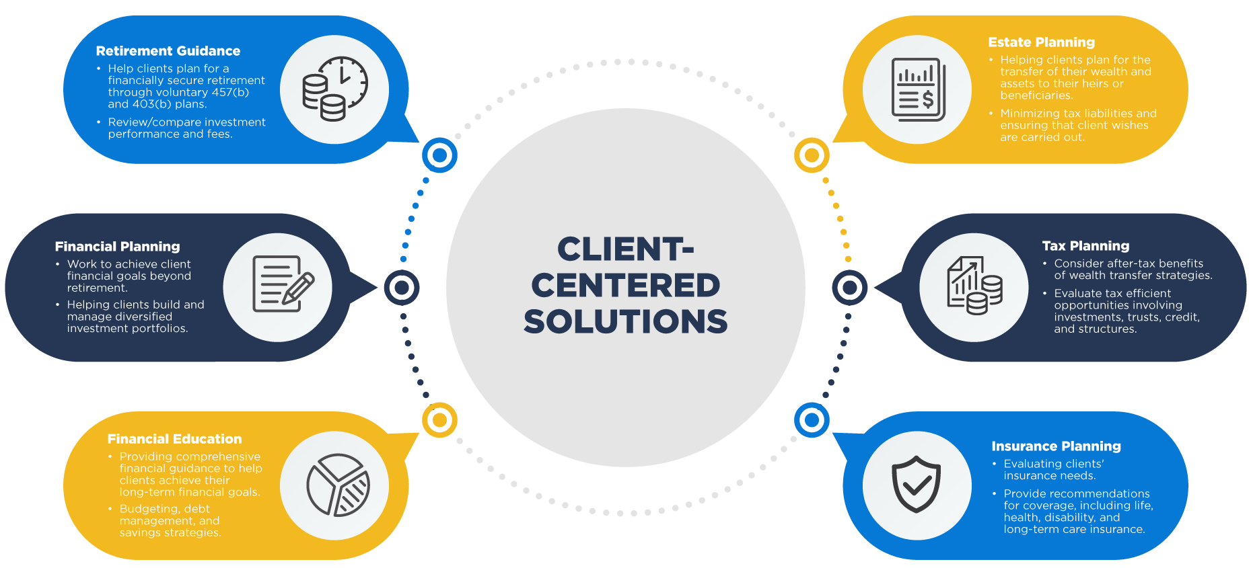

Slide 8
1
The Retirement Income Gap
www.tcgservices.com

Slide 9
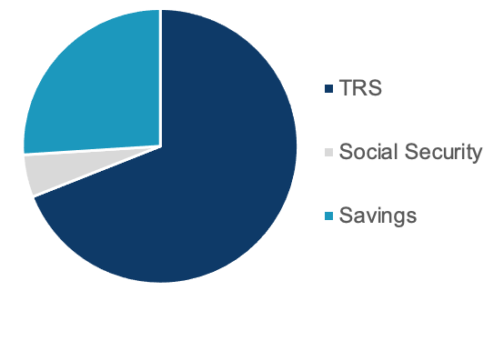
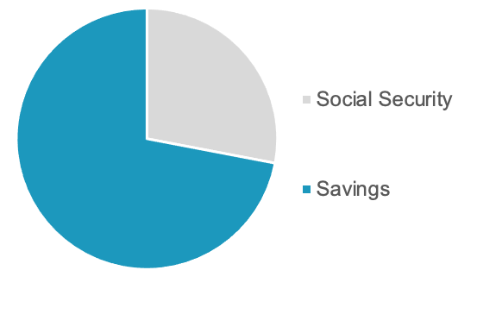
TRS vs. Corporate Retirement
Income in retirement is very different for educators than it is for their spouses and neighbors outside of education.
Educators
Neighbors
TCG, a HUB International company

Slide 10
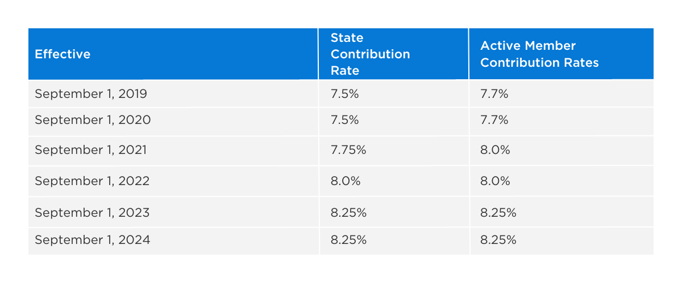
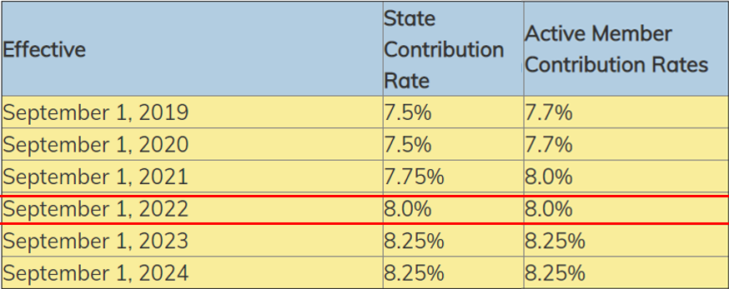
Texas Teacher Retirement System
TRS administers a pension trust fund that has been serving the needs of Texas public education employees for over 80 years.
You become a TRS member on the first day of eligible employment
TRS is a Defined Benefit Plan
Additionally, you also contribute 0.65% of your salary and the District contributes 0.75% of your salary towards TRS–Care, the retiree group health benefits program.

Slide 11
TRS Financial Awareness Series
TRS has begun an initiative focused on Financial Awareness for educators
Topics include
What you have
- Your TRS defined benefit plan What you need
- To save more How to get it
- By saving smart
WATCH AT: WWW.YOUTUBE.COM/TRSOFTEXAS
www.tcgservices.com

Slide 12
TRS Service Credit
The school year begins on September 1 each year for all TRS members. This means that TRS service and compensation credit for all members is determined based on the following dates:
September 1 through August 31
Regardless of the dates of the individuals contract work agreement, or employers' calendar.
www.tcgservices.com

Slide 13
TRS Computation Year
A minimum of 90 days.
The full fall semester in the last year before you retire.
TRS compensation is computed on the same basis
Exception for 7/1 12-month employee in last year of employment – look back to 7/1 of previous year
www.tcgservices.com

Slide 14
Grandfathered or Non-Grandfathered
Individuals who were members and met one of the following conditions by August 31, 2005 are considered Grandfathered:
At least age 50
At least 25 years of service; or
Met the rule of 70
Grandfathered : 3 years average
Non-Grandfathered : 5 years average
www.tcgservices.com

Slide 15
TRS Retirement Formula
Average 3/5 Highest Years of Income
Years of Service
State Factor (2.3%)
Maximum Benefit
X
X
=
Example
$60,000
31% net loss
of gross income
Years of Service State Multiplier Average Income
30
69%
$60,000
$41,400
Teacher
Retirement Income
Maximum Benefit
$41,400
Begin Working
Retire at Age 60
www.tcgservices.com

Slide 16
Ways to Maximize Your TRS
Increase salary (easier said than done) Increase years of service credits
Work longer
Purchase service credits
Types of services credits
Withdrawn, out-of-state, military, unreported or substitute, etc.
Cost varies depending on type of service
Contact TRS for cost estimate
www.tcgservices.com

Slide 17
Rule of 80!
The Rule of 80 is the qualifier, not the percentage
To be eligible for Normal-Age service retirement, you must meet one of the conditions within your tier
The same is true for Early-Age Retirement Eligibility
80
Age
Yrs. Of Service
www.tcgservices.com

Slide 18
What is My Tier?
Changes to the retirement plan over the years have resulted in several distinct membership categories, each with its own retirement eligibility requirements and early-age reductions.
TRS Tier 1 & 2
TRS Tier 3 & 4
TRS Tier 5 & 6
Current membership began PRIOR to September 1, 2007, and
Had at least five years of service on August 31, 2014
Current membership began BETWEEN September 1, 2007 and August 31, 2014
Had at least five years of service on August 31, 2014
Current membership began On or After September 1, 2014, or
Did not have at least five years of service on August 31, 2014
Retirement Criteria:
Rule of 80 and at least 5 years of service, or
Age 65 with at least 5 years of service
Retirement Criteria:
At least age 60, meet the Rule of 80, and at least 5 years of service, or
Age 65 with at least 5 years of service
Retirement Criteria:
At least age 62, meet the Rule of 80, and at least 5 years of service, or
Age 65 with at least 5 years of service
www.tcgservices.com

Slide 19
TRS Annuity Options
Standard Annuity | Maximum benefit for retiree’s life only
OPTION 1 |  | 100% JOINT SURVIVOR | Reduced annuity, payable for retiree’s life with continuous payments for beneficiary’s life. If beneficiary pre-deceases, retiree’s annuity is increased to standard annuity amount
OPTION 2 |  | 50% JOINT SURVIVOR | Reductions range from 4-8% based on same age beneficiary
OPTION 3 |  | 60 MONTH PERIOD CERTAIN | Reduced annuity, payable for retiree’s life with annuity payments guaranteed for a minimum of 60 months. If retiree dies before 60th payment, beneficiary will receive the remaining payments. Typically 1- 2% reduction from Standard Annuity
OPTION 4 |  | 120 MONTH PERIOD CERTAIN | Typically 1-4% reduction from Standard Annuity
OPTION 5 |  | 75% JOINT SURVIVOR | Reductions range from 6-12% based on same age beneficiary
www.tcgservices.com

Slide 20
Early-age Service Retirement
WILL MY TRS PENSION BE ENOUGH?
PENSION: TRS RETIREMENT
PERSONAL SAVINGS & OTHER ASSETS
SOCIAL SECURITY (IF APPLICABLE)
There are three pillars used to describe your retirement savings. A secure retirement would depend on two (or in some cases three) of those pillars -- your TRS pension, your personal savings, and social security. However, approximately 96% of public school employees do not pay into the social security sytem. This increases the importance of your personal savings.
Your monthly TRS contributions, as well as contributions from the state and your employer, help fund your future TRS retirement.
Upon retirement, you would receive a monthly annuity for life. Your estimated monthly standard annuity amount is
$836.72. There are no automatic increases to your annuity once you have retired.
Your personal savings and other assets may supplement your TRS pension at retirement. Contact your financial planner to discuss personal savings options that may be available to you.
If you are currently contributing or have contributed in the past, you may receive a social security benefit. To determine if you are eligible for social security and estimate potential benefits, contact the Social Security Administration. Two federal social security provisions could impact your social security benefits — the Government Pension Offset and the Windfall Elimination Provision.
457(b) or 403(b) helps
TCG can help explain WEP & GPO
www.tcgservices.com

Slide 21
Partial Lump Sum
Possible Reasons to Do
Poor Health
Estate and Critical Need for Heirs (e.g., disabled child)
Other Estate Needs — Guarantees money to heirs instead of reversion to retirement system at death
No Savings Going into Retirement
Reasons Not to Do
You will not be able to invest the money and beat the Retirement System
Pay Actuarial Cost for funds; Usually have to earn minimum Net 11.00% if try to match State — Can you do this with no risk??
You have not planned for inflation and budget in retirement so your income runs short later
You will be tempted (and give in) to spend the money you planned to save
Note Partial Lump Sum (PLSO) Eligibility
5 Year Average - Rule of 90
3 Year Average - Rule of 80
www.tcgservices.com

Slide 22
Other Items
QDROs
Must be approved by TRS
Should run by TRS before finalized
TRS Rule that can change the QDRO
Check Your TRS Statement!
Unreported service credit can only be corrected if pointed out to TRS within 5 years
Correction of Compensation and/or Service Records
No correcting information will be accepted by TRS after the member has retired and received the first annuity check
Texas Government Code Sec. 804.005
Designed to provide retirement income for spouse once member can retire
Can significantly reduce growth in member’s future TRS benefit increases
www.tcgservices.com

Slide 23
2
Your District’s Retirement Savings Plans
www.tcgservices.com

Slide 24
Additional Options for Educator Retirement Savings
Employer-sponsored plan types
Individual plan types
457(b) Savings Plan
403(b) Savings Plan
Traditional IRA
Roth IRA
www.tcgservices.com

Slide 25
Comparison of 403(b) & 457(b)
_{403(b)}
_{457(b)}
Feature
Individual vs Group Plan | Most have higher fees, pay commissions/ sales loads. Limited number of no commission options | Low fees relative to most 403(b) plans; no commissions; full disclosure of fees
Penalty to withdraw funds (+ income tax) | 10% unless qualified exception is met | None
Investment Options | Fixed / Variable interest annuities or Mutual Fund / Custodial accounts | Target Date Funds, Risk-Based Portfolios, or Self-directed Mutual Funds
Access to Funds | Termination of employment, Death, Disability, Retirement, Age 59½ (even if still employed), Hardship or Loan | Termination of employment, Death, Disability, Retirement, Age 59½ (even if still employed), Unforeseen Emergency, Loans
Investment Committee/ Advisor Oversight | No | Yes, overseen by school district superintendents and chief financial officers
Contribution Limits (can contribute to both plan types) | 2024: $23,000; $30,500 age 50+ | 2024: $23,000; $30,500 age 50+
www.tcgservices.com

Slide 26
About Roth Savings
Common perception is that it’s an IRA only
Can be used for 403(b), 457(b), 401(k)
Not eligible in all plans, must check specific plan and employer availability
See your plan description here: www.region10rams.org/documents
Roth is a distinctive retirement program and refers to the tax treatment of employee’s contributions, growth, and distributions
www.tcgservices.com

Slide 27
Benefits of Contributing
Avoid a gap in your income during retirement
Take advantage of tax benefits Improve your financial wellbeing Automatic payroll deductions
Decrease your dependency on pension plans
Save up to $23,000 (or $30,500 if age 50+) in 2024
www.tcgservices.com

Slide 28
403(b)
Retirement Plan
www.tcgservices.com

Slide 29
What is a
403(b) Savings Plan?
A 403(b) is a voluntary retirement savings plan designed for employees of state and local governments
You can make contributions directly from your paycheck to a retirement account
Contributing to a 403(b) savings plan can help bring financial stability for life upon retirement
Note: Early withdrawals from a 403(b) account are subject to a 10% penalty unless a qualified exception is met
www.tcgservices.com

Slide 30
403(b) Plan Investments
Investments in the plan are managed by a provider of your choosing
If you elect to contribute to a 403(b) plan, you should do your research and pick a vendor that matches your investment goals
Pay attention to fees, expense ratios, and the investment lineup
Plan administration services are provided by TCG, helping you with account distributions, transfers, loans, and rollovers
www.tcgservices.com

Slide 31
403(b) Vendor Examples

Slide 32
403(b) Plan Administration
TCG Administrators works with the RAMS program to provide administration services, including:
Enrolling in a new account (remember you must enroll with a vendor first)
Electing/changing your salary contribution amounts or vendor
Directing your salary contributions to the 403(b) vendor of your choice
Reviewing and approving loans/distributions daily
Full IRS compliance of account transactions and plan document

Slide 33
How to get started
First, you must research and select a from a list of investment vendors and open an account
View approved vendors here: www.region10rams.org/documents
Next, decide how much you want to contribute and create an account with TCG Administrators
Create your account here: www.region10rams.org/enroll
www.tcgservices.com

Slide 34
457(b)
Retirement Plan
www.tcgservices.com

Slide 35
What is a
457(b) Savings Plan?
A 457(b) is a voluntary retirement savings plan designed for employees of state and local governments, as well as many tax-exempt organizations
While you may qualify for a government pension, payments may not be enough to replace your pre-retirement income
Contributing to a 457(b) plan can help you enjoy tax benefits, reduce your retirement income gap, and get on track for living a comfortable life after retirement
www.tcgservices.com

Slide 36
RAMS 457(b)
Plan Highlights
Plan is overseen by Superintendents and Chief Financial Officers, ensuring the needs of public employees are addressed
Fiduciary oversight by TCG Advisors
No 10% early withdrawal tax (regular income tax still applies)
Access to financial education
Retirement Plan Specialist available to help you enroll
Free access to FinPath Wellness - financial education platform
Tax and estate planning services included with your plan
Start contributing with as little as $25 per paycheck!
www.tcgservices.com

Slide 37
RAMS 457(b) Account Holder Perks
Included at no cost to you
FinPath Financial Wellness Estate Planning
FinPath is a financial wellness program designed to help you build better financial habits and help your dollars can go farther.
Here’s what you get:
Spending a bit of time creating an estate plan can help you prepare for the expected and unexpected.
Redeem a complimentary will‡ (valued at $259) to help you secure your legacy and your loved ones.
Unlimited 1:1 confidential financial coaching
Financial health tools to help you budget, reduce debt, plan for emergencies, explore student loan forgiveness, and more!
Tax Preparation
We can help you take the stress away from your tax bill. Our team can assist with filing your W-2 tax returns at no cost to you and or a $250 credit towards complex preparation services.‡
FinPath University financial education workshops and courses
Monthly giveaways, including a $1,000 sweepstakes
*Registration is required to use FinPath. †Services may be offered through third-party vendors. **TeleWealth virtual meetings provided by TCG Advisors, a HUB International company. ‡Tax and estate services may be provided through third party vendors.

Slide 38
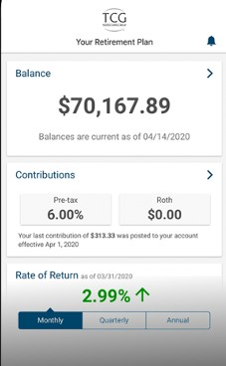
RAMS 457(b) Plan Investments
Target Date Funds
6 Model Portfolios
Preservation
Conservative
Moderately Conservative
Signature Portfolio
Growth
Aggressive Growth
15+ Mutual Funds: Choose own allocation
High Quality, No-Load and Load-Waived
Low Cost Funds
www.tcgservices.com

Slide 39
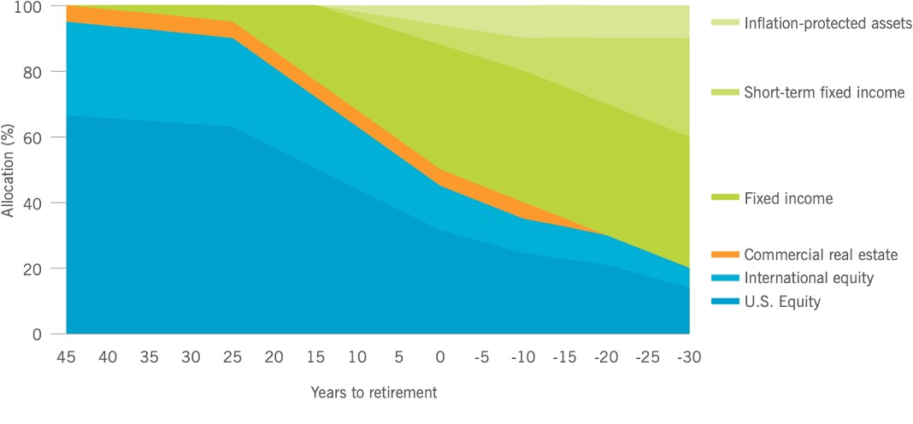
Target Date Funds
TIAA-CREFF Lifecycle Funds glidepath: Allocations become more conservative over time
www.tcgservices.com

Slide 40
RAMS Investment Advisory Committee (IAC)
Meets every quarter to review investments and all matters of the plan
Made up of Superintendents and CFOs from participating districts
TCG Advisors does research for and gives suggestions to the IAC
Underperforming funds are put on “Watch List”
The IAC has authority to replace underperforming investments

Slide 41
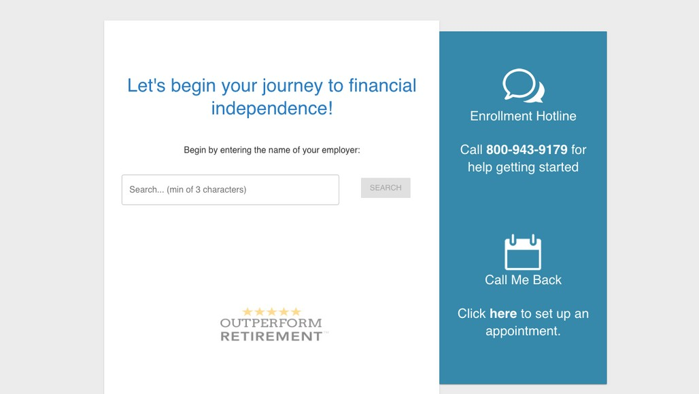
How to get started
Saving with a 457(b) is easy!
Get started at www.region10rams.org/enroll
Type in your Employer and click Register by the 457(b) Plan
Select your contribution amount and designate a beneficiary
And that's it! Saving is as easy as 1, 2, 3!
1
2
3
www.tcgservices.com

Slide 42
3
Social Security Provisions
www.tcgservices.com

Slide 43
IMPORTANT:
Your TRS Annuity is never reduced by Social Security.
www.tcgservices.com

Slide 44
Social Security Considerations
2 REGULATIONS
Government Pension Offset (GPO)
Windfall Elimination Provision (WEP)
Applies to member’s SPOUSAL Social Security benefits
(SSA Pub No. 05-1007)
Applies to member’s OWN Social Security benefits
(SSA Pub No. 05-10045)
www.tcgservices.com

Slide 45
Government Pension Offset
SPOUSAL BENEFIT
This law uses a two-thirds offset rule
Two-thirds of your TRS Annuity benefit will be subtracted from your spousal SS benefit
Does NOT reduce TRS Pension Benefit
Current Law Exemption: You have to be employed by a SS- covered District for your last 60 months to be eligible
www.tcgservices.com

Slide 46
Government Pension Offset
SPOUSAL BENEFIT
TRS Pension: $2,100
Spousal SS Benefit: $1,000
Subtract 2/3 of TRS benefit from eligible SS benefit
TRS Pension: $2,100
Spousal SS Benefit: $1,600
Subtract 2/3 of TRS benefit from eligible SS benefit
SS BENEFIT | $1,000
- (2/3 of $2,100) | $1,400
 | -$400
SS BENEFIT | $1,600
- (2/3 of $2,100) | $1,400
 | -$200
TRS Member is not eligible for spousal benefit but receives full TRS annuity
TRS Member is eligible for spousal benefit of $200 plus full TRS annuity

Slide 47
Windfall Elimination Provision
Does NOT reduce TRS Pension Benefit
Affects employees who are eligible for their OWN government/state pension and Social Security
Uses a factor to calculate your SS benefit income based on ‘Years of Substantial Earnings’
Different than ‘Service Credits’ under SS
www.tcgservices.com

Slide 48
SS Service Credits vs. Years of Substantial Earnings
Service Credits under Social Security (SS)
Eligible for 4 credits per year ($1,640 per credit)
Total of 40 credits to qualify for a benefit
For 2024, received 4 credits if earned $6,920
Year of Substantial Earnings
Higher income number
May accumulate all Service Credits under SS without earning Years of Substantial Earnings
www.tcgservices.com

Slide 49
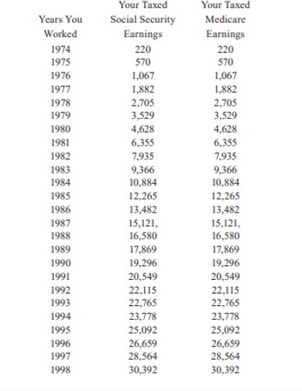
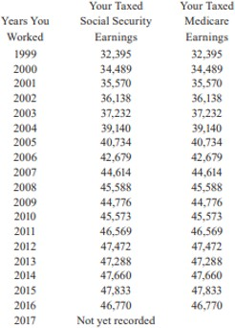
Sample Social Security Statement
Your Earning Record
www.tcgservices.com

Slide 50
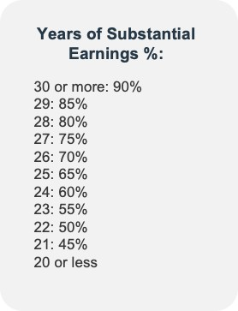
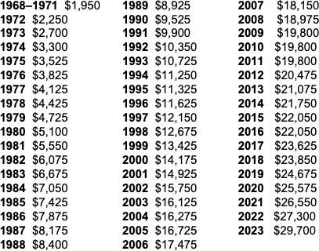
Windfall Elimination Provision
YOUR BENEFIT
Years of Substantial Earnings:
2024
$31,275
www.tcgservices.com

Slide 51
WEP Formula
EXAMPLE: AIME of $1,500 who becomes eligible in 2024 and has 20 years of Substantial Earnings
REGULAR FORMULA
WEP FORMULA
90% of first $960 | $864.00 | 40% of first $960 | $384.00
32% over $960 through $5,785 | $172.80 | 32% over $960 through $5,785 | $172.80
15% over $5,785 | $0.00 | 15% over $5,785 | $0.00
TOTAL: | $1,036.80 | TOTAL: | $556.80
www.tcgservices.com

Slide 52
4 Easy Action Items
1
Write down your goals and know the cost
Retirement Income
Other: Travel, second homes,
children/grandchildren gifts, etc.
2
Know your projected retirement income
MyTRS – www.trs.texas.gov
Social Security – www.ssa.gov
2
Identify cash flow issues
Develop a budget
Public Service Loan Forgiveness
4
Address your current savings strategy
403(b) / 457 accounts Investment allocation

Slide 53
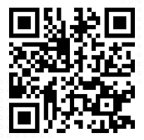
Can we answer any questions?
Get 1:1 help at: www.tcgservices.com/telewealth
Scan QR code

Slide 54
Contact us
512-600-5204
Advisor Hotline
advisors@tcgservices.com
www.tcgservices.com
www.tcgservices.com

Slide 55
Important Disclosures
Investment advisory services offered through HUB Investment Partners LLC, an SEC registered investment advisor f/k/a TCG Advisors LLC.
HUB Investment Partners is a registered investment advisor regulated by the U.S. Securities and Exchange Commission (SEC), subject to the Rules and Regulations of the Investment Advisor Act of 1940, and is a part of HUB International. Registration does not imply a certain level of skill or training. TCG Advisors’ parent company, HUB International, owns and operates several other entities which provide various services to employers across the U.S. Those affiliates sometimes provide services to TCG Advisors’ Clients. These affiliates are TCG Consulting Services, LLC, and TCG Administrators, LP (f/k/a JEM Resource Partners, LP). The business activities of these companies are discussed in its ADV Part 2A. TCG Advisors is located in Austin, Texas, and a copy of its Form ADV Part 2 and Part 3 are available upon request.
This presentation is not authorized for use as an offer of sale or a solicitation of an offer to purchase investments in any of the plans discussed or an affiliated entity. An investment in the plans carries the potential for loss. This presentation is for informational purposes only and does not constitute an offer to sell, a solicitation to buy, or a recommendation for any security, or as an offer to provide advisory or other services in any jurisdiction in which such offer, solicitation, purchase or sale would be unlawful under the securities laws of such jurisdiction.
Past performance may not be indicative of any future results. No current or prospective client should assume that the future performance of any investment or investment strategy referenced directly or indirectly in this report will perform in the same manner in the future. Different types of investments and investment strategies involve varying degrees of risk—all investing involves risk—and may experience positive or negative growth. Nothing in this presentation should be construed as guaranteeing any investment performance.
An investment in the plans discussed will involve a significant degree of risk, and there can be no assurance that the investment objectives will be achieved or that an investment therein will be profitable. The hypothetical performance presented herein reflects the reinvestment of dividends and other earnings, the deduction of all management fees, performance-based allocations, brokerage fees and other expenses applicable to the Fund. Investors will experience individual returns that vary materially from those illustrated in this presentation depending on various factors, including but not limited to, the timing of their investment, the level of fees, and the effects of additions and withdrawals from their capital accounts. Certain of the performance information presented herein are unaudited estimates based upon the information available to the Firm as of the date hereof, and are subject to subsequent revision as a result of the Fund’s audit. Past performance is not necessarily indicative of the future performance or the profitability of an investment in a plan. An investment in a plan will be subject to a wide variety of risks and considerations as detailed in the offering documents. The information set forth herein will be qualified in its entirety by the information set forth in the offering documents.
This presentation includes forward-looking statements. All statements that are not historical facts are forward-looking statements, including any statements that relate to future market conditions, results, operations, strategies or other future conditions or developments and any statements regarding objectives, opportunities, positioning or prospects. Forward-looking statements are necessarily based upon speculation, expectations, estimates and assumptions that are inherently unreliable and subject to significant business, economic and competitive uncertainties and contingencies. Forward-looking statements are not a promise or guaranty about future events. TCG.35.2023
www.tcgservices.com

